Slide 1
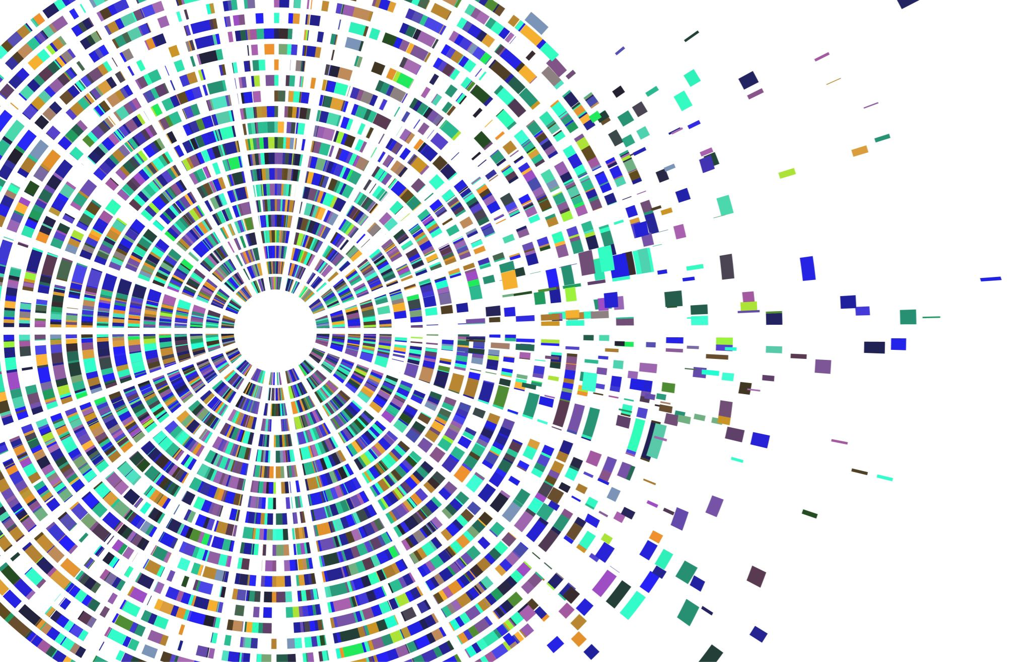
Whole-Genome Sequencing & Social-Network Analysis of a Tuberculosis Outbreak Gardy et al. (2011)
Molecular Epidemiology Case Study 1
Molecular Epidemiology Training Series
August 28, 2026

Slide 2
Learning Objectives
Interpret combined genomic and epidemiological data to understand transmission.
Interpret genetic diversity and mutation rates to define active clusters.
Translate genomic findings into targeted public health interventions.

Slide 3



Outbreak Context & Investigative Approach
The Outbreak
Genomic Sequencing
Social Network Overlay
A sudden 3-year Tuberculosis surge occurred in British Columbia. Standard MIRU-VNTR typing showed identical patterns, raising fears of a novel hyper-transmissible superbug.
Sequenced 36 M. tuberculosis isolates (32 outbreak, 4 historical) down to single-nucleotide polymorphisms (SNPs) to build precise phylogenetic trees.
Integrated genomic trees with contact tracing data and shared location networks to map exact transmission chains and resolve contact blindspots.

Slide 4
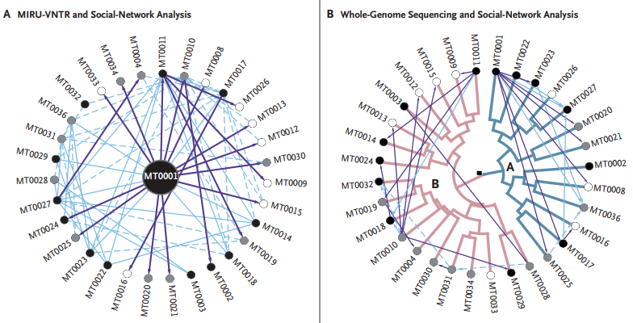
Key Findings
1. Genomic SNP mapping revealed two distinct bacterial lineages (Lineage A & B) co-circulating under identical traditional MIRU-VNTR fingerprints.
2. Rather than a novel genetic mutation, the surge was triggered by increased crack cocaine use in shared, poorly ventilated locations acting as transmission hubs.

